Slide 1
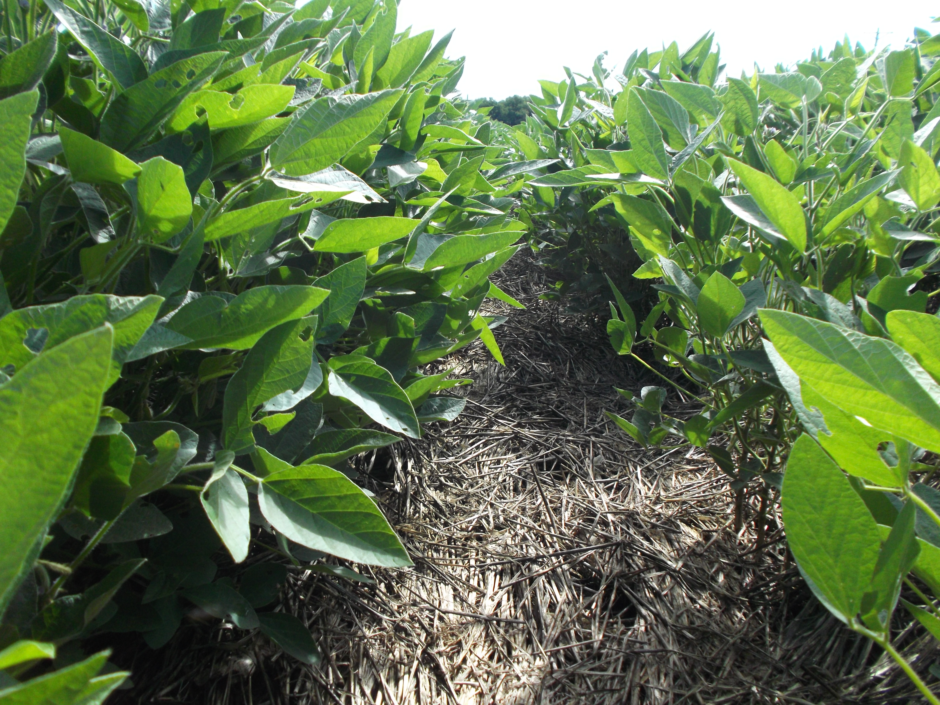

Cover crops for weed control: What have we learned from Corn Belt experiments
Dr. Andrea Basche, Assistant Professor, Cropping Systems
Department of Agronomy and Horticulture
2019 Weed Management Field Day
June 26, 2019
Notes:
Andrea Basche, started at UNL in teaching and research Dec 2017 so just into my second year
Went to ISU for grad school where I did work on CCs
Going to talk today about cover crops and weeds… know you’ve already heard some about them today but really want to emphasize on the weed control opportunities
Want to start by getting you a little bit involved –

Slide 2
Tell us about your cover crop experience
Who has experience growing a cover crop?
What are the largest benefits of cover crops in Nebraska?
Soil health
Erosion prevention
Water quality improvement
Livestock
Weed suppression
Notes:
Great. Thank you.
Glad to see that some of you have experience w/ cover crops
Not surprised that most folks do not immediately associate their benefits for weed control
Will share what we’ve learned in doing a review of research across CB and see what you think might be more opportunities for their use in this arena

Slide 3
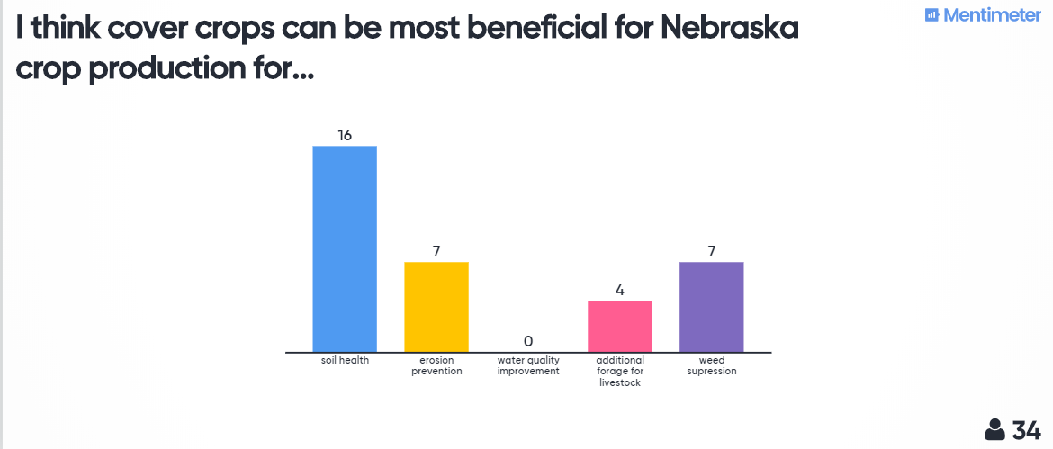

Slide 4
Topics
Review of cover crop impact on weeds across Corn Belt
Opportunities for weed management with cover crops in Nebraska
Additional cover crop opportunities (time permitting)
Managing herbicide resistant weeds
Reductions in herbicide use

Slide 5
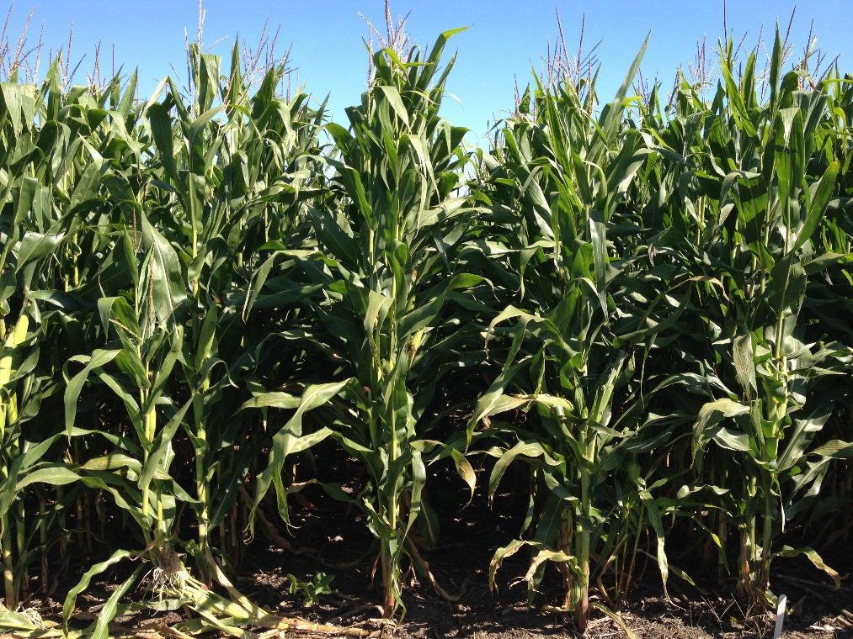
Why consider cover crops for weed control in the Corn Belt?
Dominant corn-soybean cropping systems
Highly productive with issues (soil erosion, water quality)
Cover crops can address these concerns but…
What is the potential for cover crops to reduce weeds and offset herbicide costs given cropping system constraints?
Notes:
Why did I embark on this project? I have been working on a review of published research across the CB with colleagues at ISU and PFI
Ive had the opp to interact w/ a lot of other professionals around the US working on cover crops and its clear – as you can all imagine that the Midwestern Corn Belt is different than other places corn and soy are grown in the SE or MidAtlantic states – we grow fairly consistently the largest number of corn acres & represents about 80% of national production of corn and soybean
And in many of the CB states the majority of cropped acres are corn/soy
Highly productive region – no doubt, but that has come at the cost of continued soil and water quality degradation-
Not going to say more about that other than cc can close the fall/winter/spring bare soil window BUT what is that impact on weeds. Can cc’s offset herbicide costs and improve short term economics for producers
We think this is a super important question for our region / environment / climate–so what can cover crops do based on what the data says given the limited heat units available in that fall window– hypothesize that we can cut costs – farmers tell us this

Slide 6
Method and rationale for the review
Meta-analysis: Systematic method to summarize prior research
Targeted key word search of experiments from database of publications
Criteria:
Corn Belt state
Includes measurements of weed density (amount of weeds) or weed biomass (size of weeds)
Only fall planted cover crop before corn or soybean
Only difference is +/- cover crop
Can look for patterns of what is most (or least) effective such as termination methods, cover crop species, amount of cover crop biomass
Cover crop
No cover crop
Notes:
Meta-analysis is a quantitative, systematic method to synthesize prior research. The power of such an analysis is that it allows us to investigate overall trends of a particular treatment by combining results from many different experiments.
-Search science database for previously published research experiments
-Only include experiments that collected weed biomass or weed density –
fall planted CC, before corn or soy, and that had an experimental design that included treatments and controls only differing in the presence of a cc
Again really allows us to look across range of experiments for patterns

Slide 7
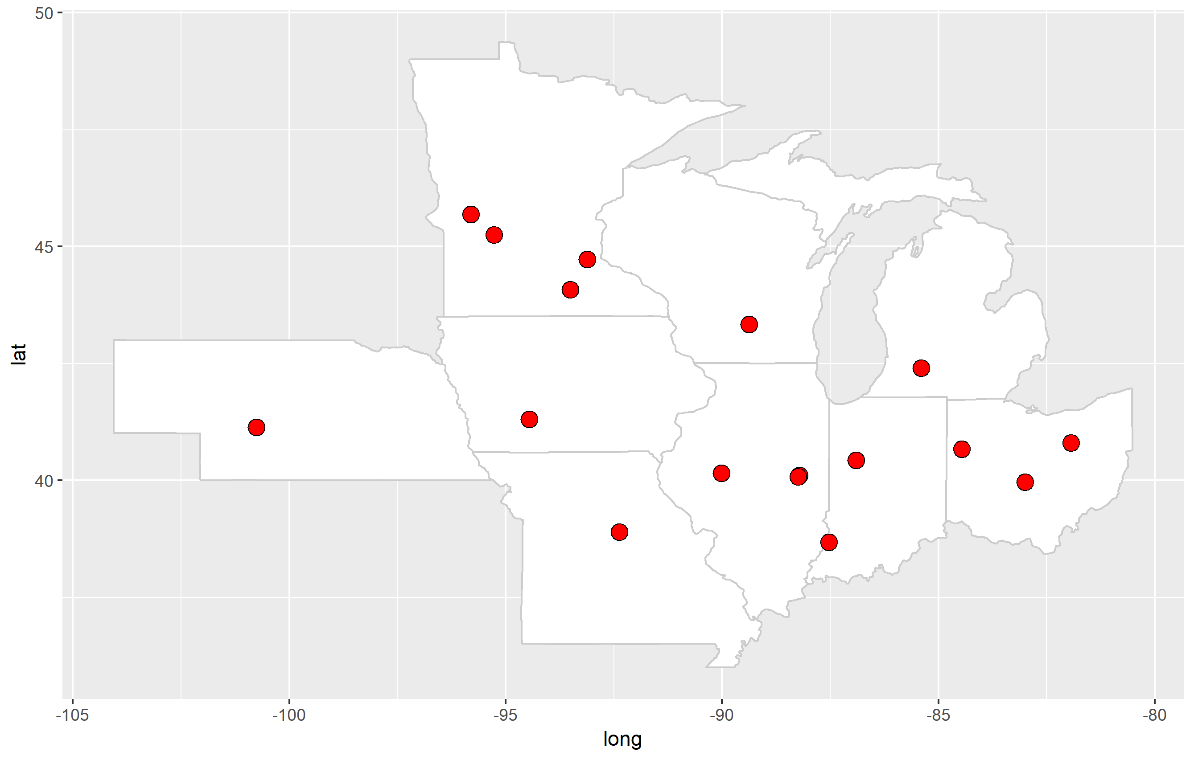
Experiment locations
*Corn Belt = Illinois, Indiana, Iowa, Kansas, Michigan, Minnesota, Missouri, Nebraska, North Dakota, Ohio, South Dakota, and Wisconsin
Original
Updated
Notes:
We have analyzed results in a lot of detail from fifteen different experiments across nine states (Figure 1), including one in Nebraska.
Since we made the map have looked at a few more that I’m showing here – in KS and another in Eastern NE
So we’ve considered 17 experiments in analysis

Slide 8

Summary of results
Across the Corn Belt, experiments show that cover crops are generally more effective at reducing weed biomass (size of weeds) compared to weed density (amount of weeds).
No differences in the efficacy of weed control with different cover crop species.
No differences in weed control if an experiment planted corn or soybean following the cover crop.
Notes:
High level of what we’ve found
More experiments where cc’s reduced weed biomass rather than weed density. This suggests that cover crops may be more beneficial from the standpoint of controlling the size of weeds and thus the efficacy of an herbicide program.
This has been fairly consistent across experiments – feel pretty firm about that finding
Experiments that used herbicides or a combination of herbicides and mowing to terminate, or cover crops that were winter-killed were found to be more effective at weed control than cover crops terminated solely by crimping or mowing.
Experiments included in our analysis utilized grass, legume and mixed cover crop species. We did not find differences in the efficacy of weed control with different cover crop species.
We also did not find differences in weed control if an experiment planted corn or soybean following the cover crop.

Slide 9

Results continued
Timing is everything!
Greater weed suppression when weeds measured in the spring (at cover crop termination) versus summer (at least six weeks post corn or soybean planting)
Notes:
Most measured in the summer
Another similar analysis that looked at weed control w/ cc’s across the world – and in many different cropping systems, so grain or vegetable production
What they found was that the most benefit of cc’s on weed control came right around termination and early season main crop growth
CC’s increased vegetable yields

Slide 10
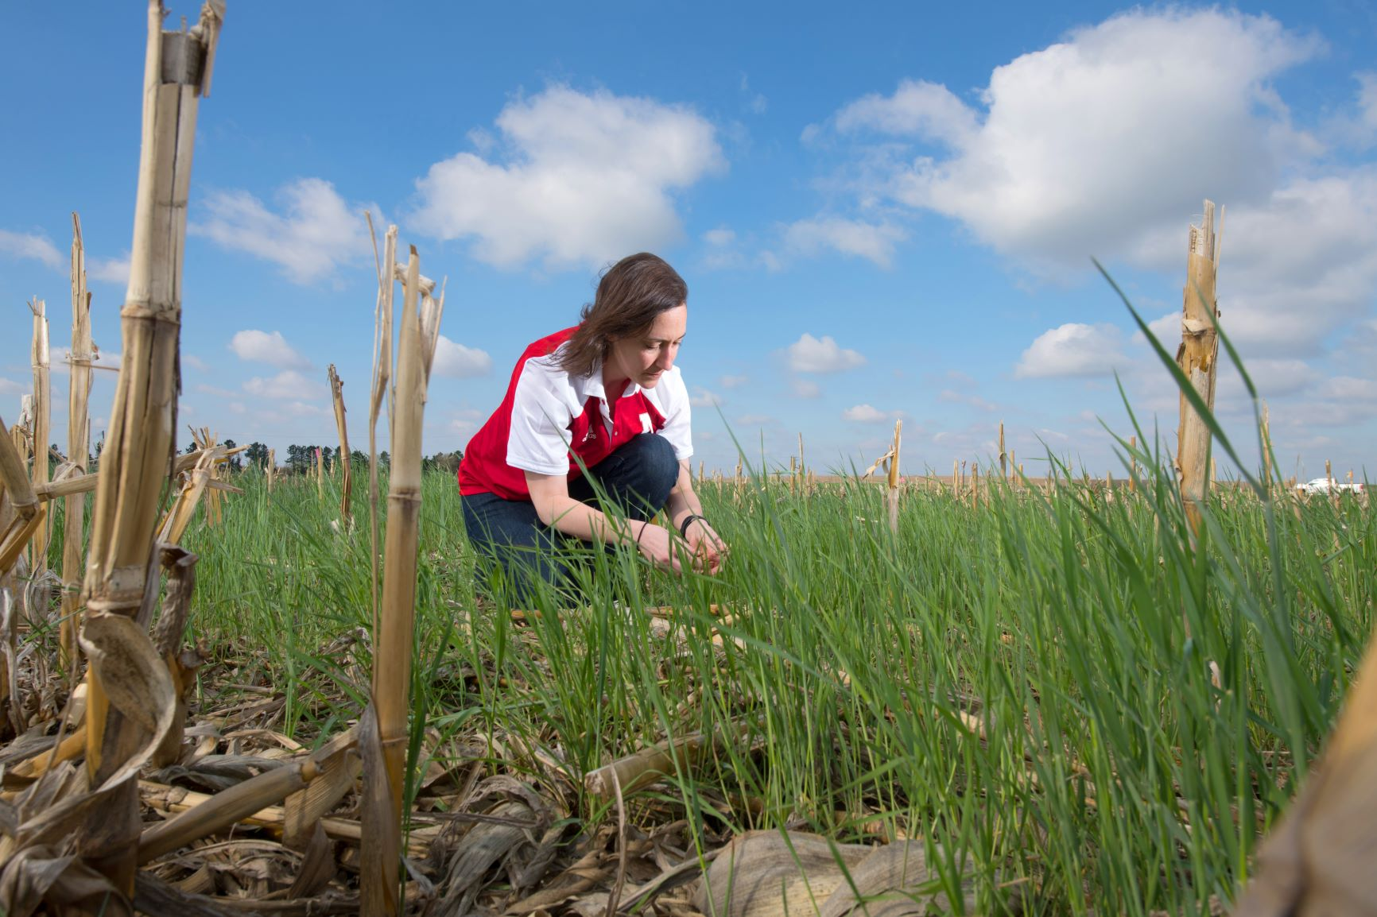
Opportunities for Nebraska
Notes:
So that’s some of the high level details we’ve learned so far from the review
What does this mean more specifically for NE, want to talk briefly about the experiments from NE in the review and other related research

Slide 11
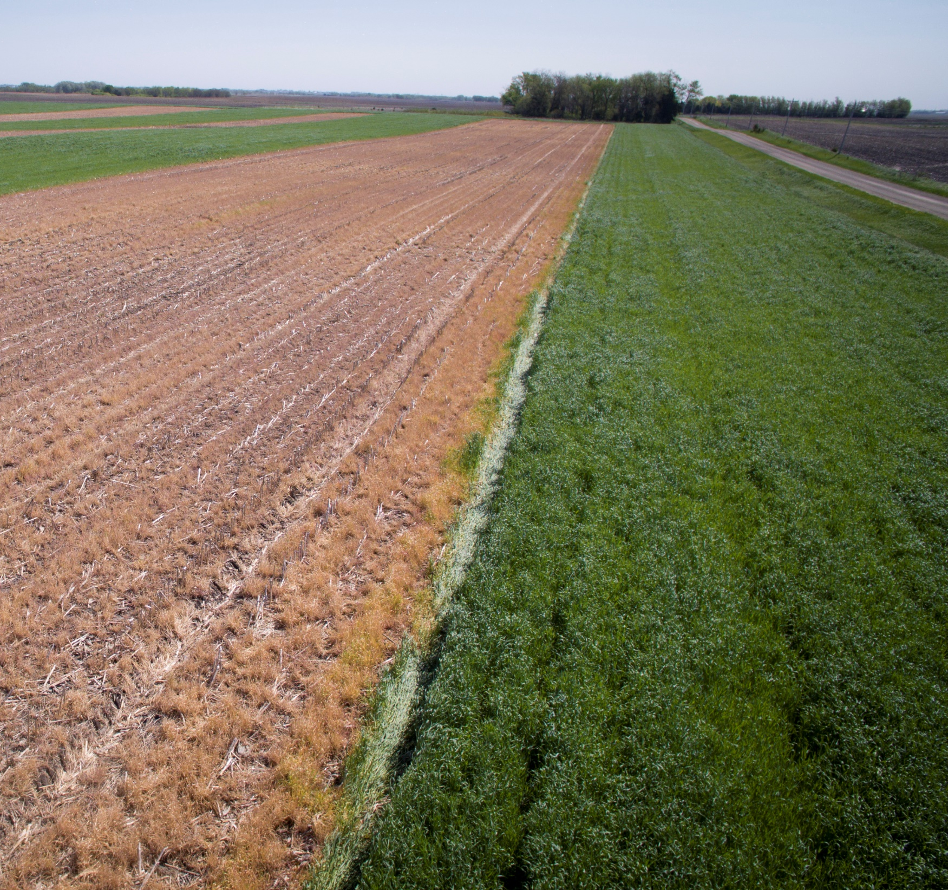
Nebraska producers succeeding with cover crops
Recent survey found that 93% of Nebraska producers believe cover crops improved weed control with cover crops
Greater control in winter annual versus summer annual weed species
Major observed changes with cover crops included reduced erosion, weed suppressed and increased soil organic matter
Oliveira et al. 2019

Slide 12
North Platte experiment in the review
The Nebraska study included in our analysis was conducted at the North Platte experiment station and on a nearby producer’s field from 2016-2017.
Both sites under no-till irrigated continuous corn management
Cover crops were planted from mid-September to mid-October in these experiments and were terminated with herbicides in mid-April.
Between 3300-3600 lbs/acre of rye biomass reduced both weed density and weed biomass by >90%
Werle et al. 2018
Notes:
Wanted to briefly mention a few more details about the experiment from Nebraska
Sandy loam soil generally – at NP producer and research station
CC drilled post harvest (one in Oct and one in Sept) -67 to 94 kg/ha – 60-80 lbs/acre
Really good weed suppression >90% reductions in weeds

Slide 13
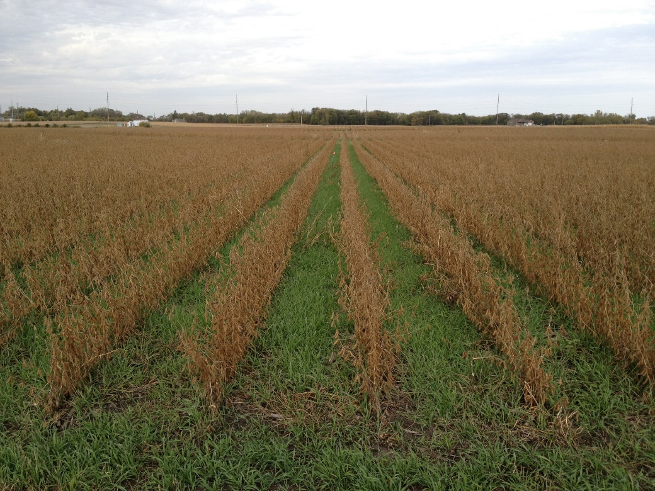
Eastern Nebraska experiment in the review
Winter cereal cover crops (barley, rye, triticale, wheat) and hairy vetch grown before soybean after corn silage
Measured weed density and biomass of foxtail, pigweed and waterhemp
Total weed density was not consistently reduced by the cover crops, although foxtail density was reduced by ~35% in some instances
All measurements showed that cover crops reduced in weed biomass by an average of 65%
Average cover crop biomass ~3000 lbs/acre, ranged from 100 lbs/acre to 6400 lbs/acre
Williams et al. 1998
Notes:
Expt conducted from 1994-1996
Reads a lot like something we’d do today
Drilled cover crops in Sept after corn silage
Planted soybean the following year
Measured
KS study – 8/9 measurements of weed biomass went down

Slide 14
What are the most important strategies for managing herbicide resistant weeds?
Proper herbicide timing
Start clean – no weeds at planting
Apply multiple modes of action
Use full labeled herbicide rates
Crop rotation
Tillage
Cover crops
Narrow row spacing

Slide 15
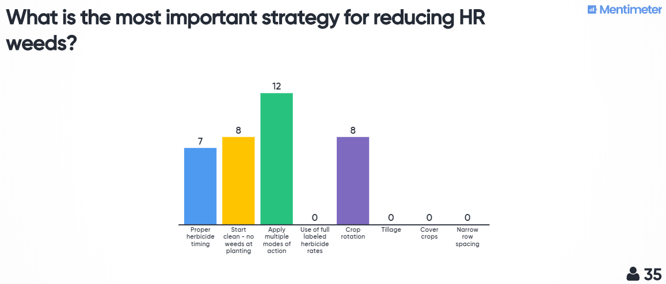

Slide 16
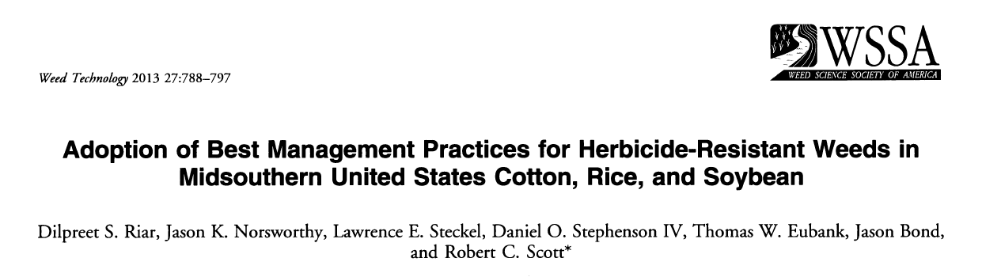
~200 crop consultants in Arkansas, Louisiana, Mississippi and Tennessee were surveyed
Herbicide methods were perceived as most effective: proper timing, clean start, using multiple MOAs, full label rights
Cultural practices considered least important: tillage, cultivation, narrow row spacing (<20 inch), cover crops, altered planting dates
Notes:
In fall 201 1, cotton and soybean consultants from Arkansas, Louisiana, Mississippi, and Tennessee were surveyed through direct mail and on-farm visits, and rice consultants from Arkansas and Mississippi were surveyed through direct mail to assess the importance and level of implementation of herbicide resistance best management practices (HR-BMPs) for herbicide-resistant weeds. Proper herbicide timing, clean start with no weeds at planting, application of multiple effective herbicide modes of action, use of full labeled herbicide rates, and prevention of crop weed seed production with importance rating of > 4.6 out of 5.0 were perceived as the most important HR-BMPs in all crops. Purchase of certified rice seed was on 90% of scouted hectares. In contrast, least important HR-BMPs as perceived by consultants with importance ratings of < 4.0 in cotton, < 3.7 in rice, and < 3.8 in soybean were cultural practices such as manual removal of weeds; tillage including disking, cultivation, or deep tillage; narrow (< 50 cm)-row crops, cover crops, and altered planting date

Slide 17
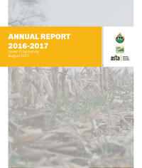
Herbicide resistant weeds
From SARE surveys: “In addition to yield increases, farmers reported other benefits to cover crops, ranging from improved soil health to better control of herbicide-resistant weeds,”
69 percent of the respondents said cover crops always or sometimes improved control of herbicide-resistant weeds.
A majority of respondents—59 percent—reported having herbicide-resistant weeds in at least some of their fields.
https://www.sare.org/Learning-Center/Topic-Rooms/Cover-Crops/Cover-Crop-Surveys
Notes:
Explain surveys

Slide 18
Herbicide resistant weeds: lessons from the Southeast
Palmer amaranth was effectively controlled with CCs + residual herbicides
Norsworthy et al. 2016 – Arkansas
Wiggins et al. 2014 – Tennessee. ~60% control of PA before cc termination
Montgomery et al. 2018 – Tennessee. ~90% control of PA post cc termination
Dual magnum was a commonly used residual in experiments. Valor, Calisto, Atrazine, Laudis were others
Cover crops + lower rates of herbicides provided effective weed control compared to controls of higher herbicide rates without cover crops (Price et al. 2006; Norsworthy 2004; Burgos and Talbert 2006; Malik et al. 2008)

Slide 19
Recent study in Pennsylvania
Cover crops reduced horseweed density by 52% in year 1 and 86% in year 2 in a no-till soybean system
Fewer large plants at the time of pre-plant herbicide application
Cover crops included oat, radish, cereal rye and hairy vetch
Rye > oat/radish > rye/radish > rye/vetch > oat > oat/hairy vetch
Range across years was ~40% to ~90% reduction in horseweed density

Slide 20
Can cover crops be used for weed control in Nebraska?
Yes! They can be a valuable tool in an integrated weed program especially to reduce weed biomass
Weather increases variability of this biological mode of action
Cover crops can be considered a mode of action that compliments chemical options for weed control
The program needs to be designed around effective cover crop use
Notes:
MOA – another way to think about ccs

Slide 21
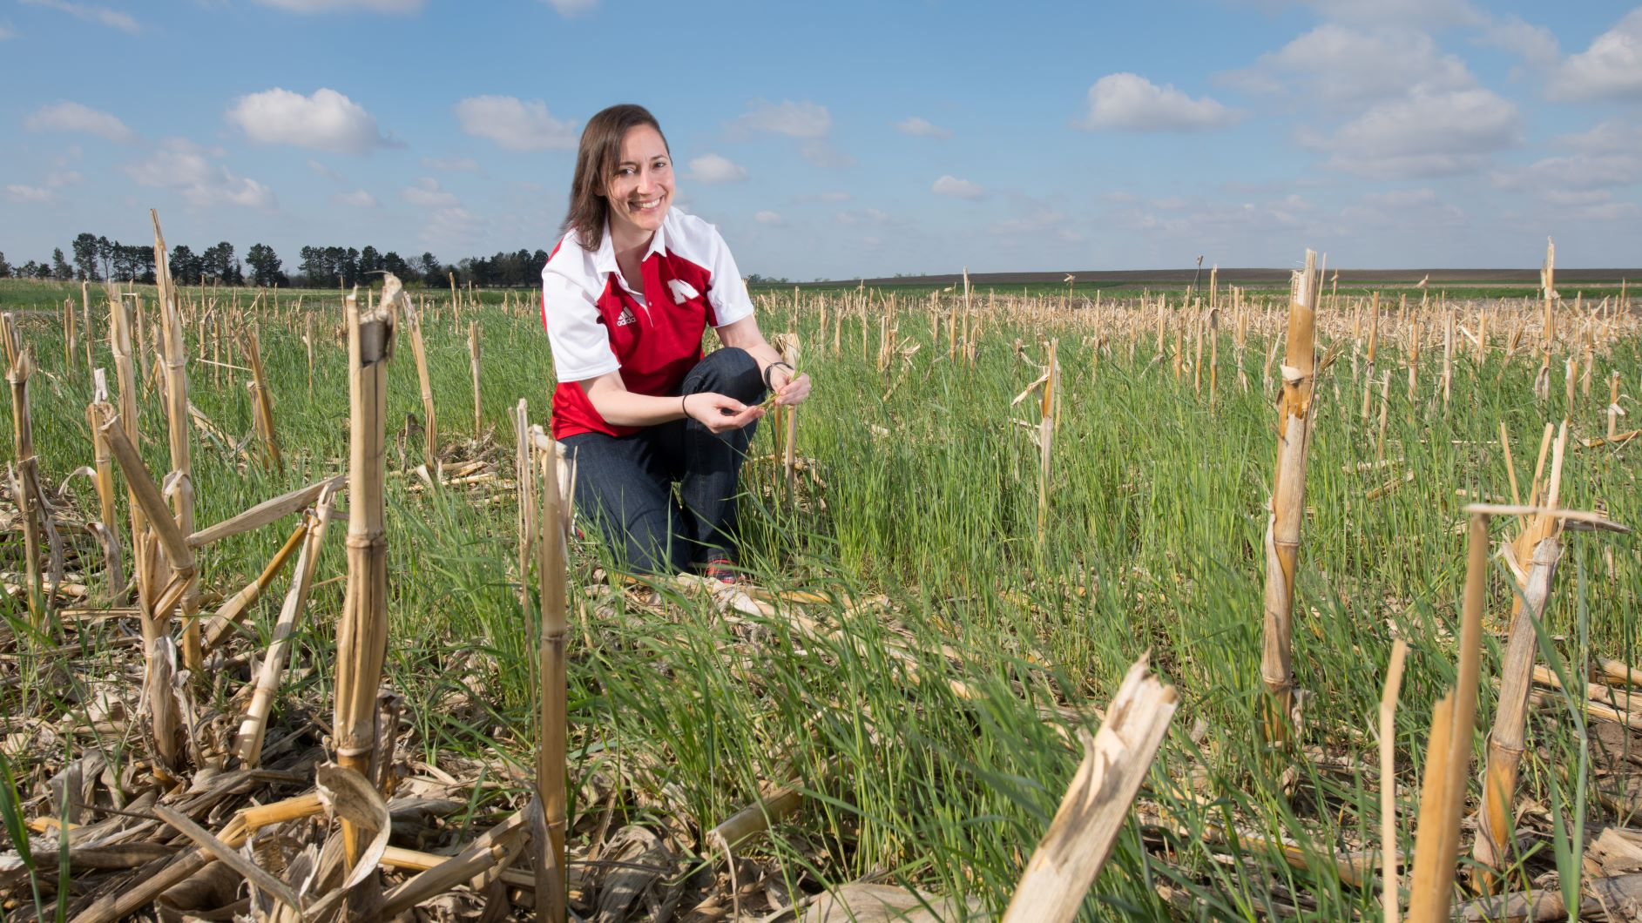
Thank you
abasche2@unl.edu
402-472-6413

